Slide 1
RADITECH HYDROMATICS PVT LTD
P-95, Jadu colony , Behala , Kolkata - 700034
COMPANY INTRODUCTION
(2025-2026)
Prepared by :
Mr. Dipayan Bhattacharjee
Engineer-Sales & Application

Slide 2
INDEX
Introduction
Vision
Registration
Our Expertise
SPM & Hydraulics
Pneumatics
Material Handling Equipment’s
Special Type Fabrication
Industrial Automation
Why RadiTech?

Slide 3
Introduction
Raditech established in November 2022,is carrying the legacy of Danver Hydromatics with its deep commitments to professionalism, It has a vision of brighter tomorrow in this modern era of globalization consisting a complete experienced and professional team.
RadiTech has the capability of providing viable solution to suit customer’s operational need. We are persistently looking for challenges are have wide assortment of services ranging from Hydro Electric project to Radiation project, from Material Handling Process Control System to Hydraulic and Pneumatic systems, we provide all types of Tailor made solutions and the spectrum of our service array is escalating recurrently.

Slide 4
Vision
Customer focused
Service
Involvement of customer
Process approach
Continuous development
Fact based decision making
Mutual beneficial relationships with the customer
Quality & Commitment

Slide 5
Registration
NTPC
SAIL
Arcelor Mittal Nippon Steel India
Jindal Stainless Limited
IFGL Refractories Limited
Rotamech Engineering & Consultants
Calderys India Refractories Limited
Rashmi Metaliks Limited
BRIT
Rungta Mines Limited

Slide 6
Our Expertise
Special Purpose Machine & Hydraulics
Pneumatics
Material Handing Equipment's
Industrial Process Automation
Special Fabrication type Equipment
Spares
Gamma Radiation Projects

Slide 7
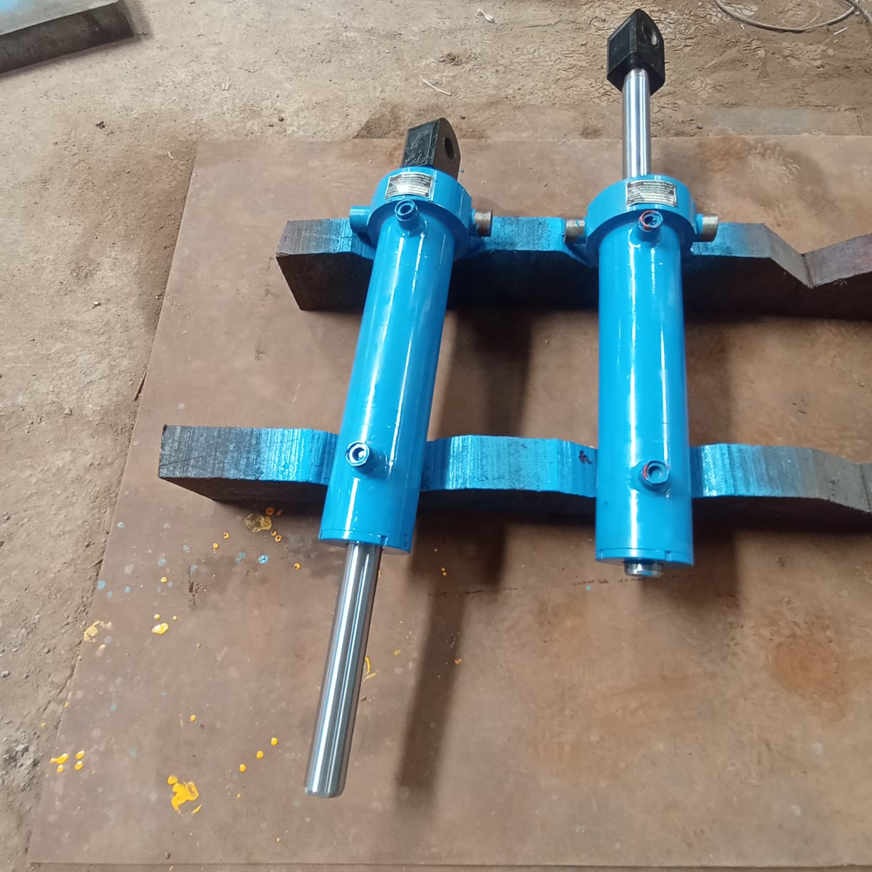
SPM & Hydraulics
Hydraulic cylinders
We manufacture hydraulic cylinders as per IS 6020.
Bore Size 25 mm to 400 mm,
Stroke ranges 10 mm to 5000 mm.

Slide 8
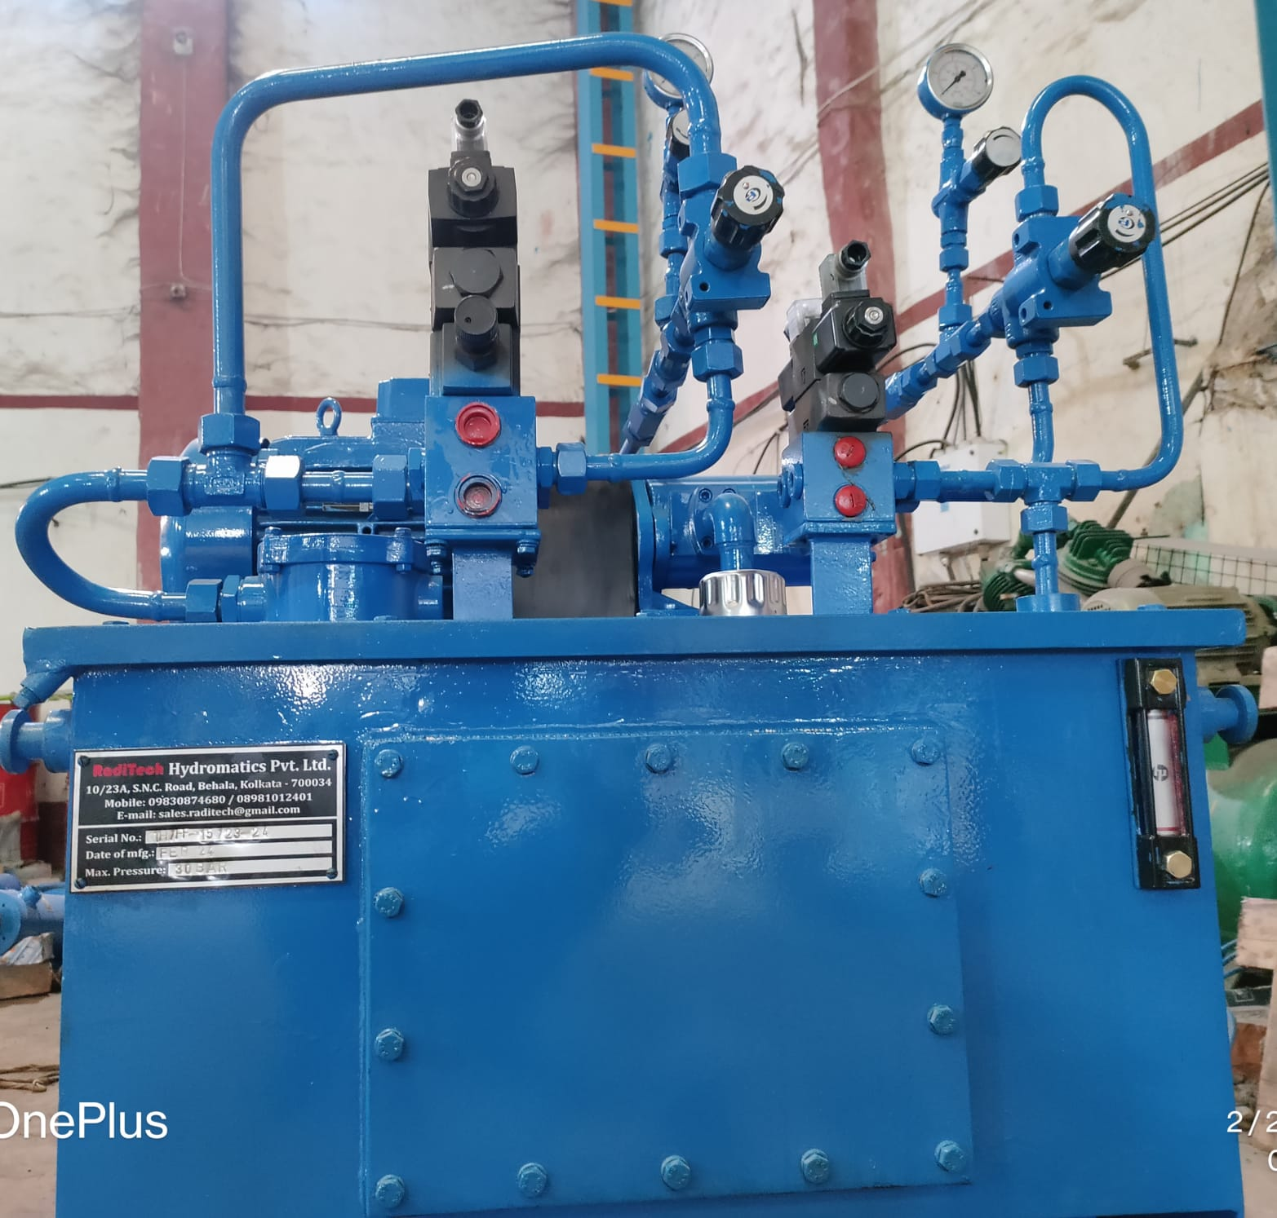
SPM & Hydraulics
Hydraulic Power pack:
Different Types of Custom Designed Power pack
with Valve Stand.
Oil tank Capacities up to 5000 Liters.
Pressure up to 400 Bar.

Slide 9
SPM & Hydraulics
Hydraulic Press:
Capacities of various Hydraulic Press:-
C-Type -Up to 60 Ton
Tie-rod Type -Up to 300 Ton
Fabricated Type -1000 Ton & above
H-Type -Up to 50 Ton

Slide 10
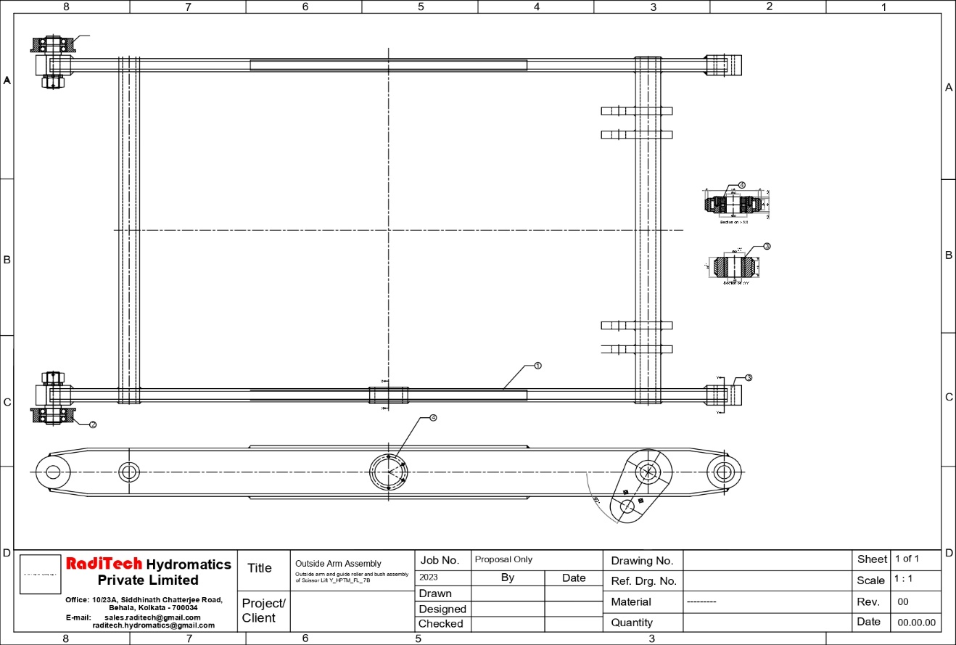
SPM & Hydraulics
Hydraulic Scissor Lift :
We design and manufacture various types of scissor lift as per client’s requirement.

Slide 11
Pneumatics
Pneumatic cylinders
We manufacture hydraulic cylinders as per IS 6431.
Bore Size 50 mm to 450 mm,
Stroke ranges 10 mm to 2000 mm.

Slide 12
Material Handling Equipment’s
We design and Manufacture various type of conveyors, vibration table along with scissor lifts as per client’s requirements.

Slide 13
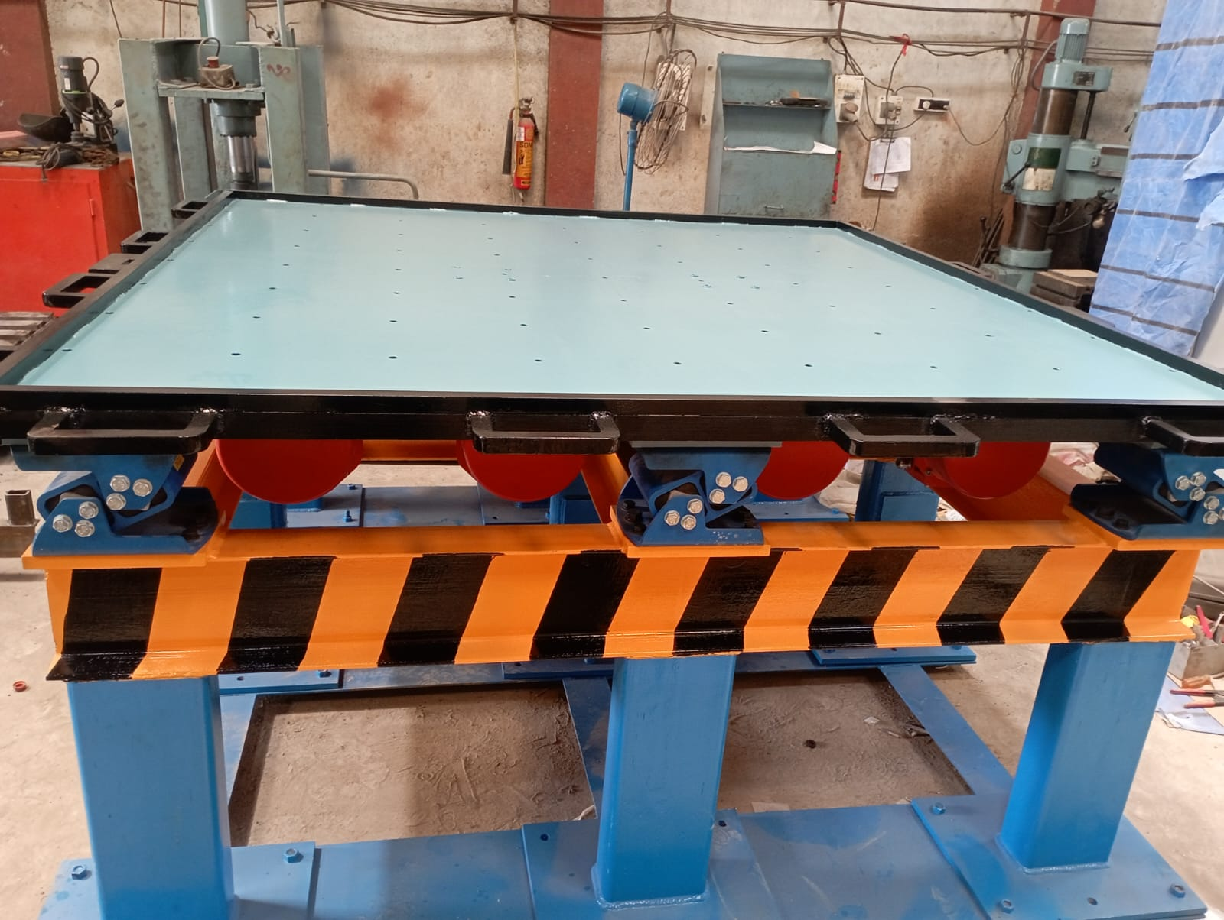
Material Handling Equipment’s
Vibration Table, Capacity 8 Ton ,Mould Size 3 M X 3 M for IFGL Refractories,Vizag

Slide 14
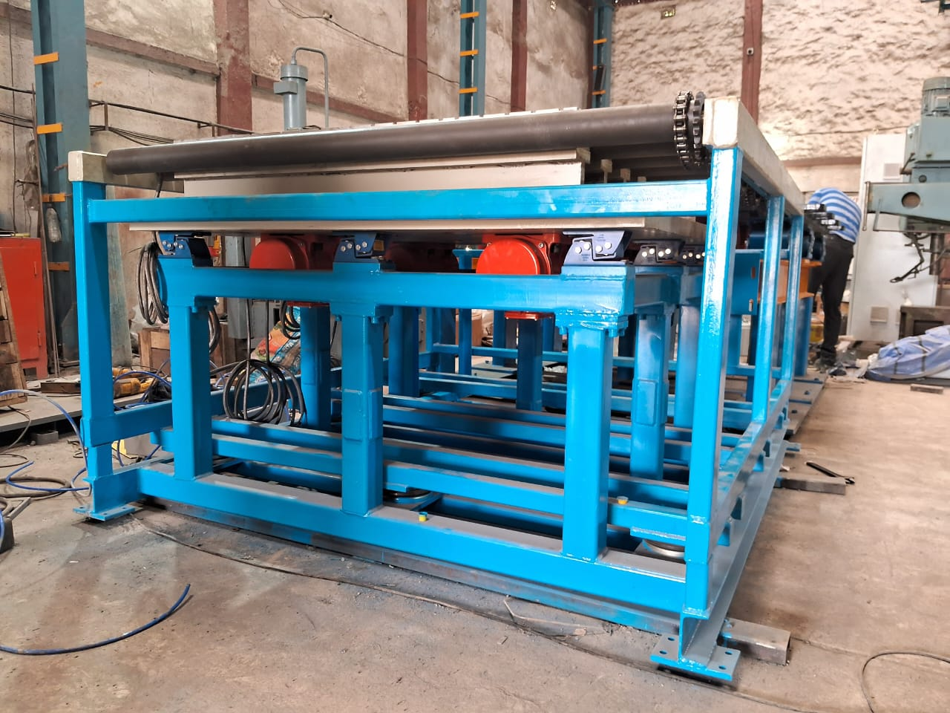
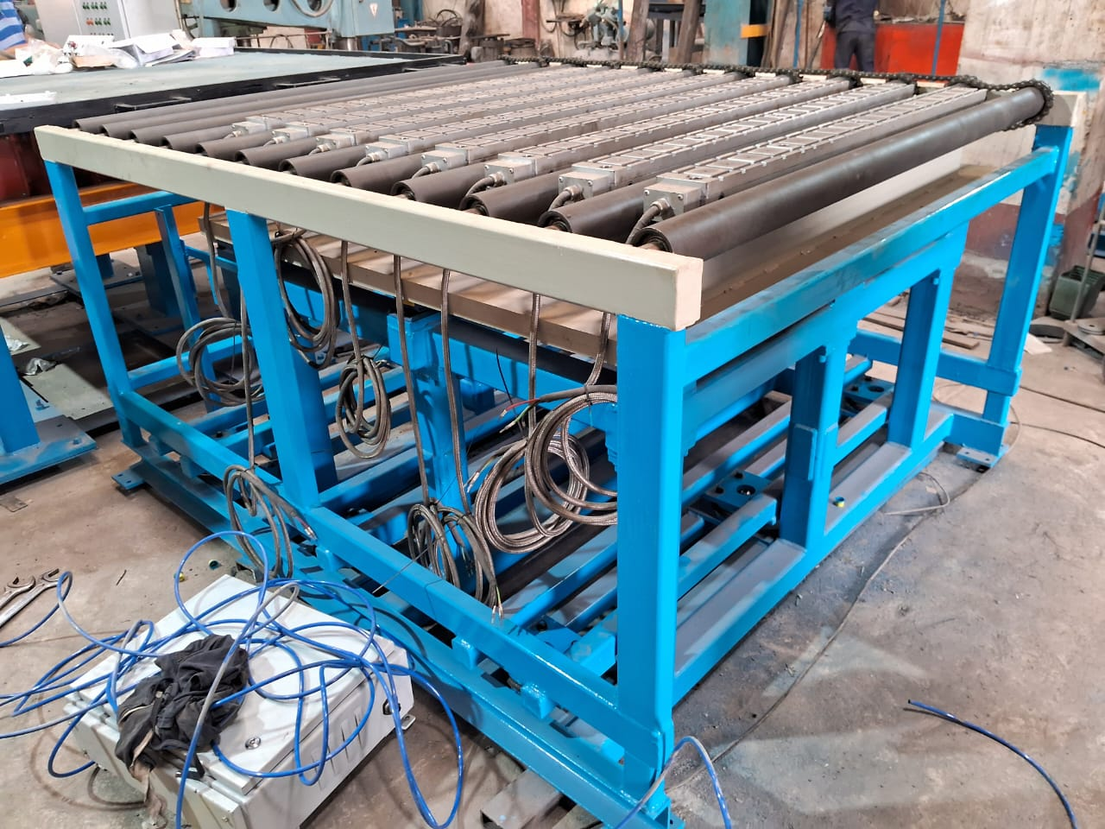
Material Handling Equipment’s
Roller Conveyors , Capacity 1 Ton , Mould size 800 mm X 800 mm ,Vibration table (1 Ton) along with electric control panel for Calderys Refractories, Odisha.

Slide 15
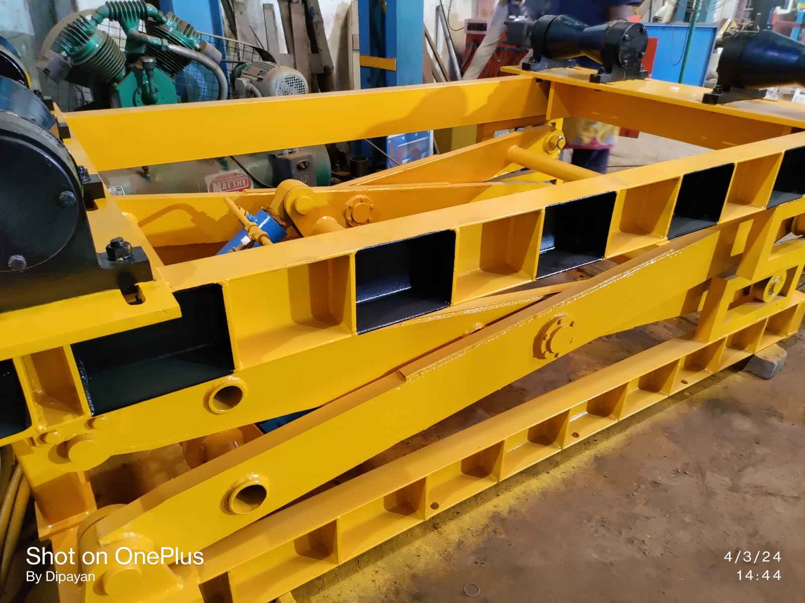
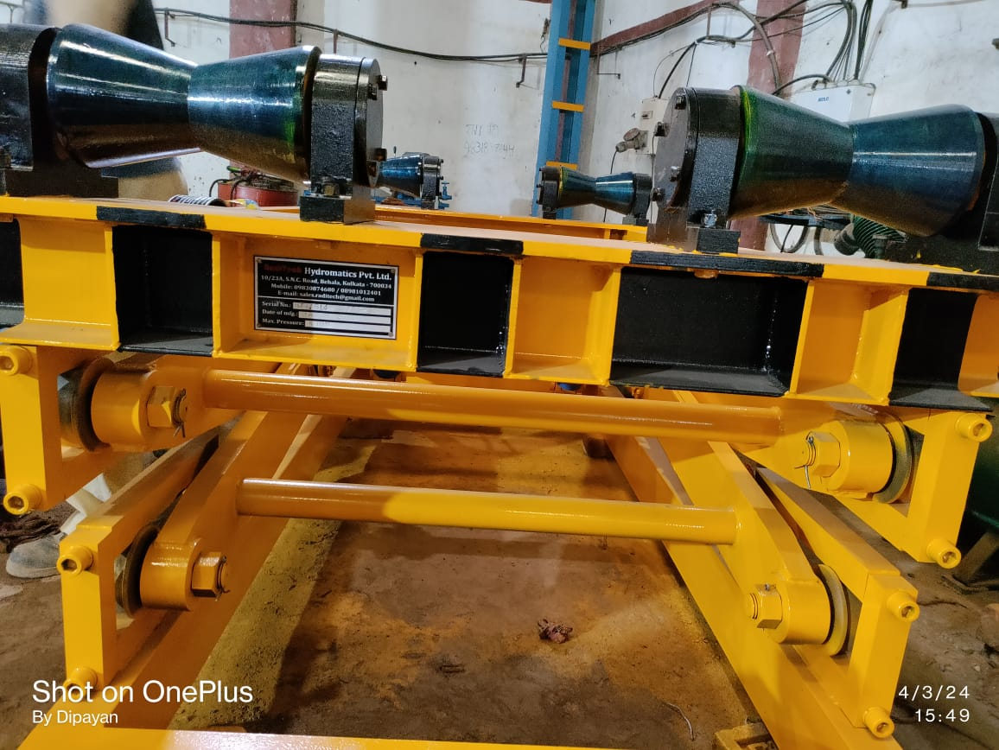
Special Type Fabrication Equipment
WBC Assembly has been supplied to DIP Division, Rashmi Metaliks Ltd, Kharagpur.

Slide 16
Industrial Process Automation
We provide superior engineering services for managing and implementing MCC, PLC,RELAY and DRIVE based project in various industries, serving both the domestic and international sectors.

Slide 17
Why RadiTech..?
Our team can provide the total solution under one roof right from Designing to
Erection & Commissioning of the System.
Our team also provide superior Engineering Services for managing and
implementing Process Automation with PLC and HMI/SCADA Systems.
We also can undertake Modification, Upgradation, Recommissioning and Development of Spares of Existing Plants. Our team also provides full assistance at Customer’s Site.
We also Supply of Spare Parts and its Installation.
It is our Endeavour to make our Customer’s Business more. Successfully & Sustainable by constantly upgrading them.

Slide 18


